Slide 1
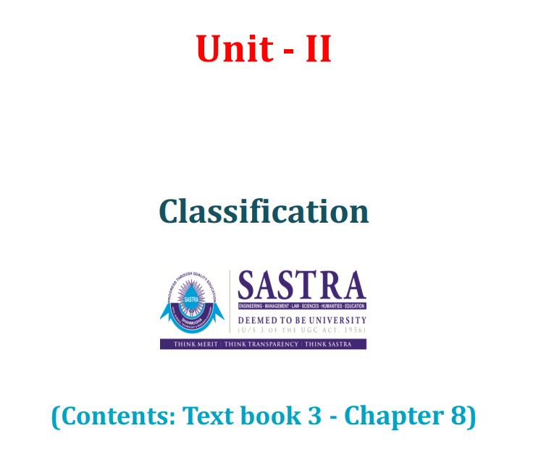

Slide 2
Classification: The problem of classification - Feature engineering - Training and testing classifier models - Statistical decision theory.

Slide 3
The problem of classification
A classification problem in machine learning is one where you categorize data instances into discrete labels or classes (e.g. “spam” vs. “not spam,” or “disease” vs. “no disease”).
It differs from regression, which predicts continuous outcomes. Classification tasks include both binary and multinomial cases, with outputs often represented as hard assignments or probabilities

Slide 4
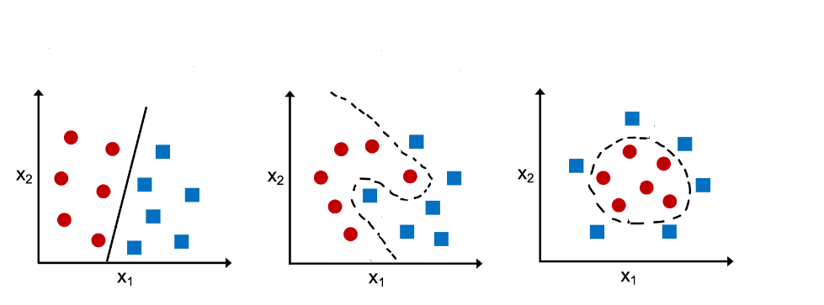
🧠 Types of Classification
Binary classification: Two categories (e.g., yes/no, high/low risk)
Multinomial (Multiclass) classification: Three or more classes (e.g., categorizing documents into topics)
Both types can produce either hard labels or class probability distributions

Slide 5
Machine learning algorithms for solving Classification Problems
Logistic regression
Decision trees
Random forest
XGBoost
Light GBM
Voting classifiers
Artificial neural networks

Slide 6
Classification Problems & Models Examples
✅ Customer Behavior Prediction
Classify customers based on:
Buying patterns
Web browsing behavior
Example use case:
Predict if a customer is likely to make more purchases
Action based on prediction:
Send promotional offers or discounts
If predicted to stop purchasing, mark for re-engagement campaigns

Slide 7
Document Classification
Multinomial classification used to categorize documents into different labels
Algorithms commonly used:
Naive Bayes
Support Vector Machines (SVM)
Neural Networks
Advanced models:
Deep Boltzmann Machines (DBMs)
Deep Belief Networks (DBNs)
Stacked Autoencoders (SAEs)
Applications:
Email sorting, topic detection, automated document tagging

Slide 8
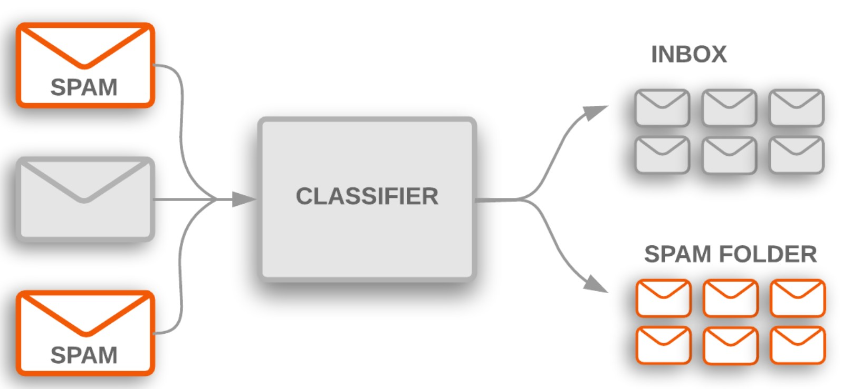
Spam Filtering
Trains a model to classify emails as spam or not spam
Learns from characteristics of spam messages (keywords, patterns)
Model maps email text → spam or non-spam label
Common algorithms:
Naive Bayes
SVM
Use case:
Automatically filter incoming emails to inbox or spam folder

Slide 9
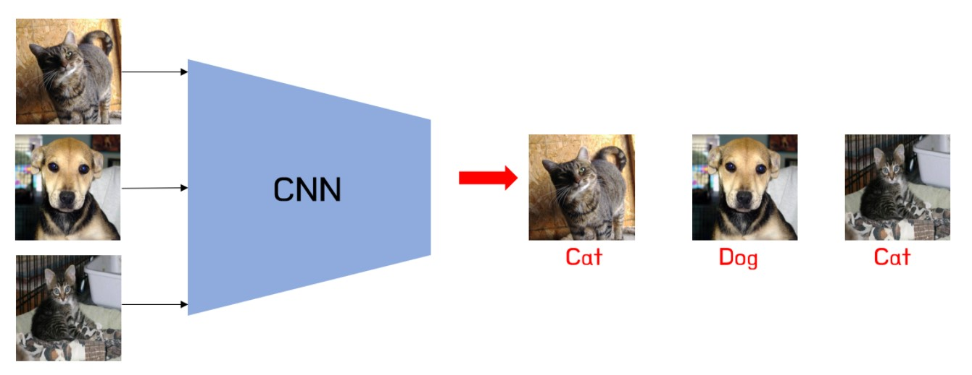
🖼️ Image Classification
Goal: Identify the object or scene in a digital image (e.g., cat, car, human)
Images are treated as high-dimensional vectors
A multinomial classification model maps these vectors to specific categories
Example:
Classifying dog and cat images in machine vision systems
State-of-the-art approach:
Convolutional Neural Networks (CNNs)
Advanced use case:
Image Segmentation:
Assigns labels to each pixel in the image
Defines meaningful image regions based on visual features

Slide 10
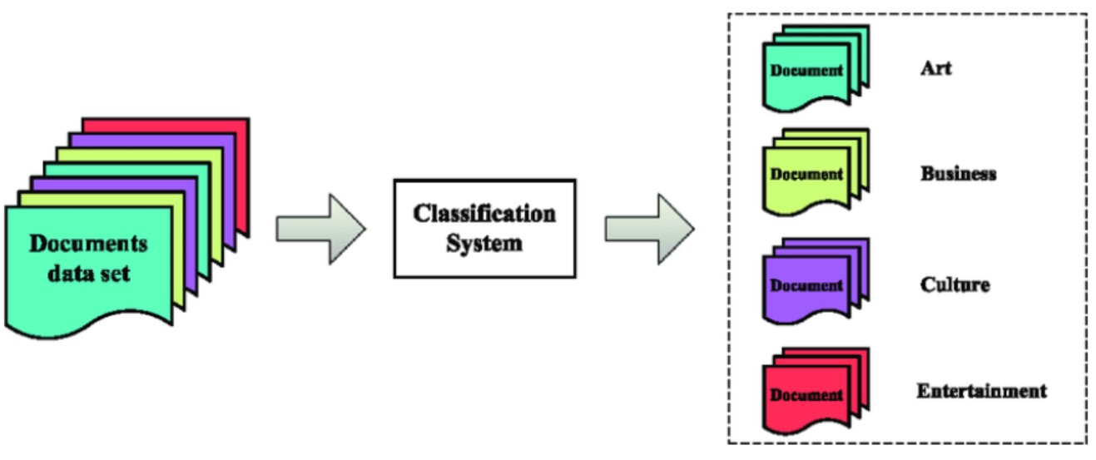
🌐 Web Text Classification
Task: Categorize web documents into topic labels (e.g., Sports, Tech, Entertainment)
Classification model maps:
Text document → Topic category
Used for:
Automatic web tagging
Content filtering
News aggregation (e.g., Google News)
Algorithms:
Naive Bayes (traditional)
Deep Learning Models (modern; better accuracy)

Slide 11
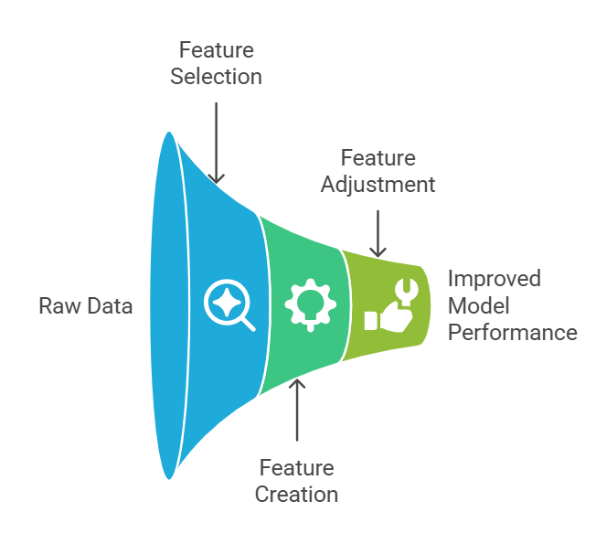
Feature Engineering
What is Feature Engineering?
Process of turning raw data into meaningful input for ML models
Involves choosing, creating, and adjusting features
Goal: Improve model performance and accuracy

Slide 12
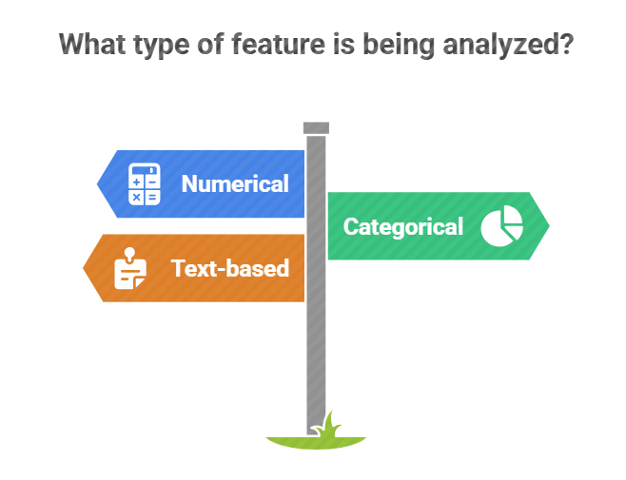
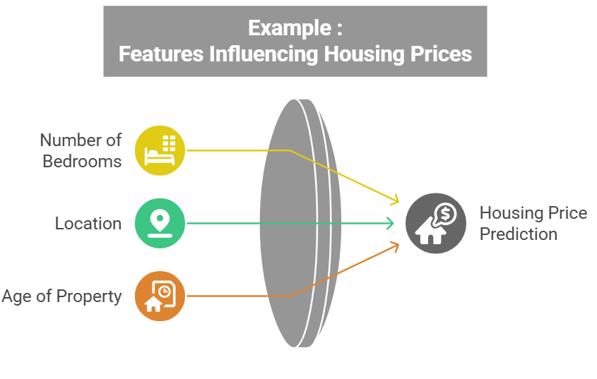

Slide 13
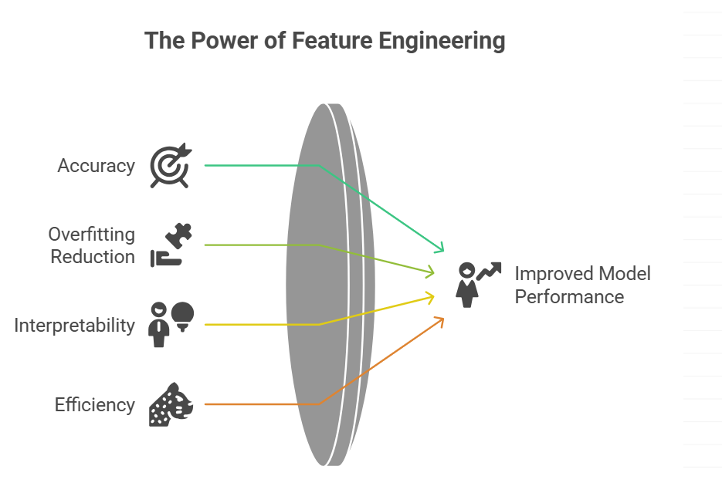

Slide 14
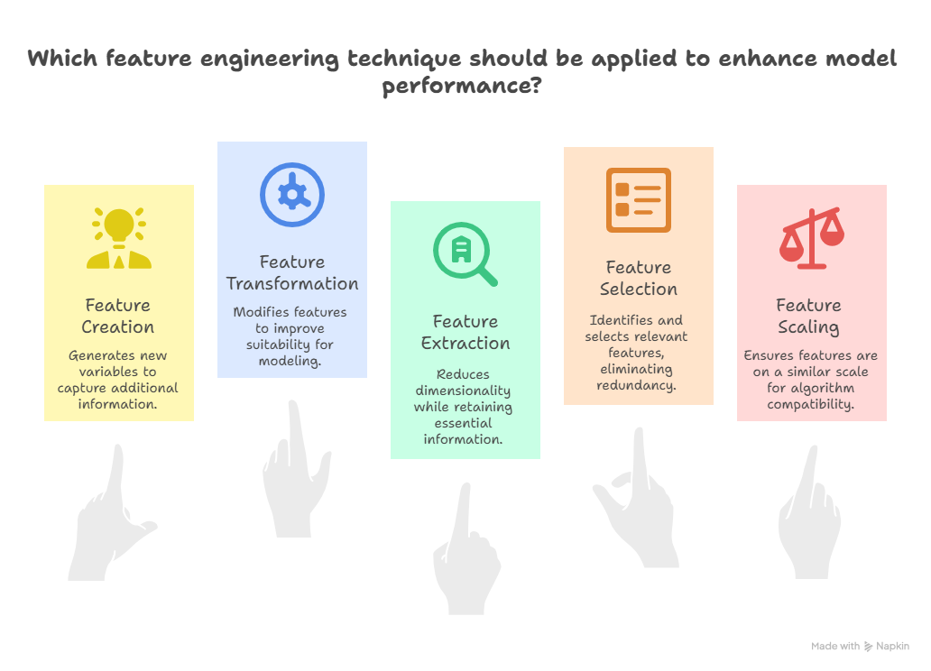

Slide 15
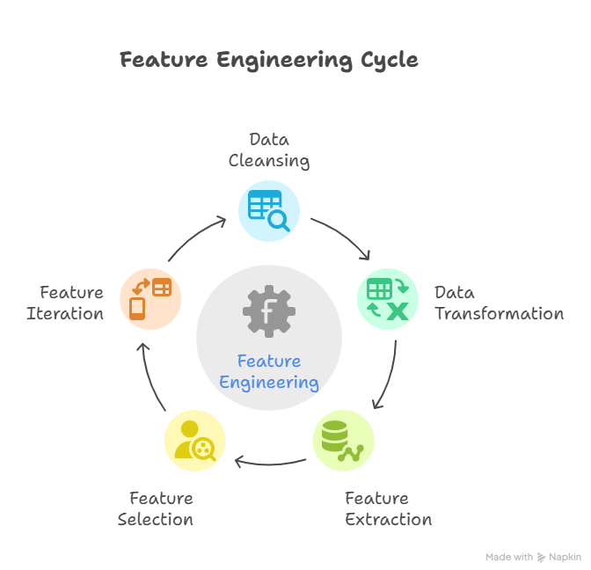

Slide 16
Steps in Feature Engineering
Data Cleansing: Identify and correct errors or inconsistencies in the dataset to ensure data quality and reliability.
Data Transformation: Transform raw data into a format suitable for modeling including scaling, normalization and encoding.
Feature Extraction: Create new features by combining or deriving information from existing ones to provide more meaningful input to the model.
Feature Selection: Choose the most relevant features for the model using techniques like correlation analysis, mutual information and stepwise regression.
Feature Iteration: Continuously refine features based on model performance by adding, removing or modifying features for improvement.

Slide 17
Statistical Decision Making in Machine Learning
What is decision making in ML?
Role of statistics in choosing optimal outcomes
Applications: fraud detection, diagnostics, recommendation engines

Slide 18
Types of Decisions in ML
Classification vs Regression
Hard vs Soft classification
Probabilistic vs Deterministic decision-making

Slide 19
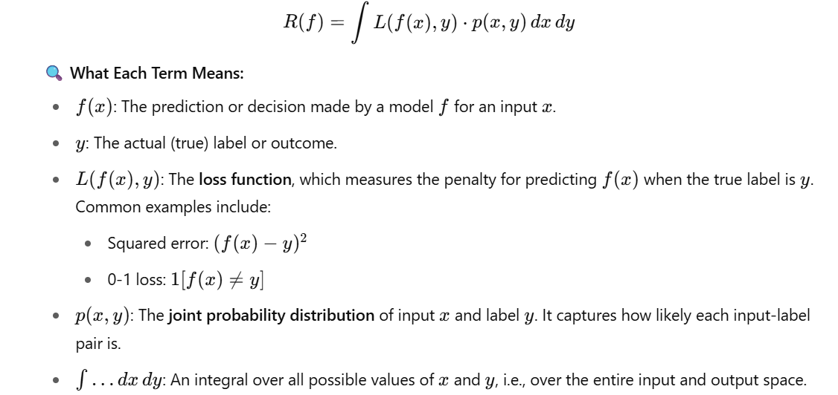
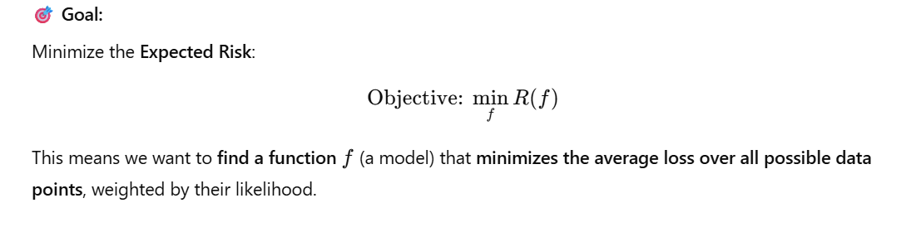
Key Concepts
Hypothesis Space: Set of all models
Decision Function f(x): Predicts outcome from input
Loss Function L(y, ŷ): Measures error in decision
Risk Minimization Principle

Slide 20
Summary
Statistical decision making formalizes ML decisions
Minimizing risk leads to optimal models
Foundation for supervised learning strategies

Slide 21
Classifiers: Naïve Bayes classification - Bayesian networks - Decision Tree Classifier - Random Forest Classifier - K-Nearest Neighbor classification - Support Vector Machines.

Slide 22
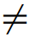
8.3.2 Naive Bayesian Classification
The naive Bayesian classifier, or simple Bayesian classifier, works as follows:
Let D be a training set of tuples and their associated class labels.
As usual, each tuple is represented by an n-dimensional attribute vector, X = (x₁, x₂,..., x_{n}), depicting n measurements made on the tuple from n attributes, respectively, A₁, A₂,..., A_{n}.
Suppose that there are m classes, C₁, C₂,..., C_{m}. Given a tuple, X, the classifier will predict that X belongs to the class having the highest posterior probability, conditioned on X.
That is, the naive Bayesian classifier predicts that tuple X belongs to the class C_{i} if and only if P(C_{i} |X) > P(C_{j} |X) for 1 ≤ j ≤ m, j i.

Slide 23
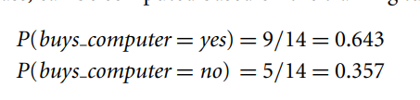
8.3.2 Naive Bayesian Classification
As P(X) is constant for all classes, only P(X|C_{i})P(C_{i}) needs to be maximized.
If the class prior probabilities are not known, then it is commonly assumed that the classes are equally likely,(all have same probability of occurrence) that is, P(C₁) = P(C₂) = ··· = P(C_{m}).
Note that the class prior probabilities may be estimated by P(C_{i}) = |C_{i},D|/|D|, where |C_{i},D| is the number of training tuples of class C_{i} in D.

Slide 24
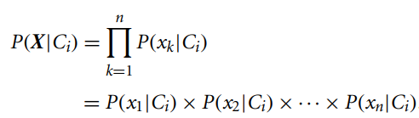
8.3.2 Naive Bayesian Classification
Given data sets with many attributes, it would be extremely computationally expensive to compute P(X|C_{i}).
To reduce computation in evaluating P(X|C_{i}), the naive assumption of class-conditional independence is made.
This presumes that the attributes’ values are conditionally independent of one another, given the class label of the tuple (i.e., that there are no dependence relationships among the attributes).
Thus,

Slide 25
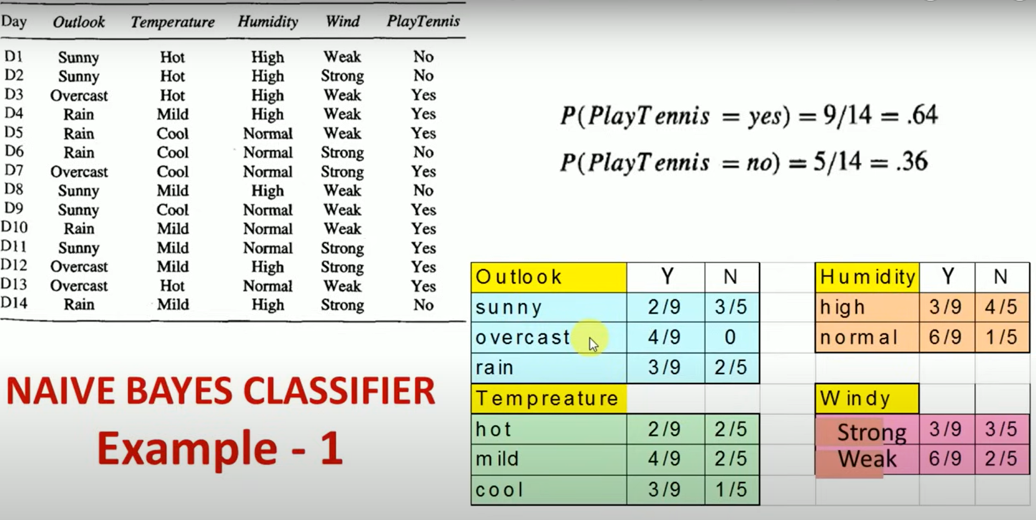

Slide 26
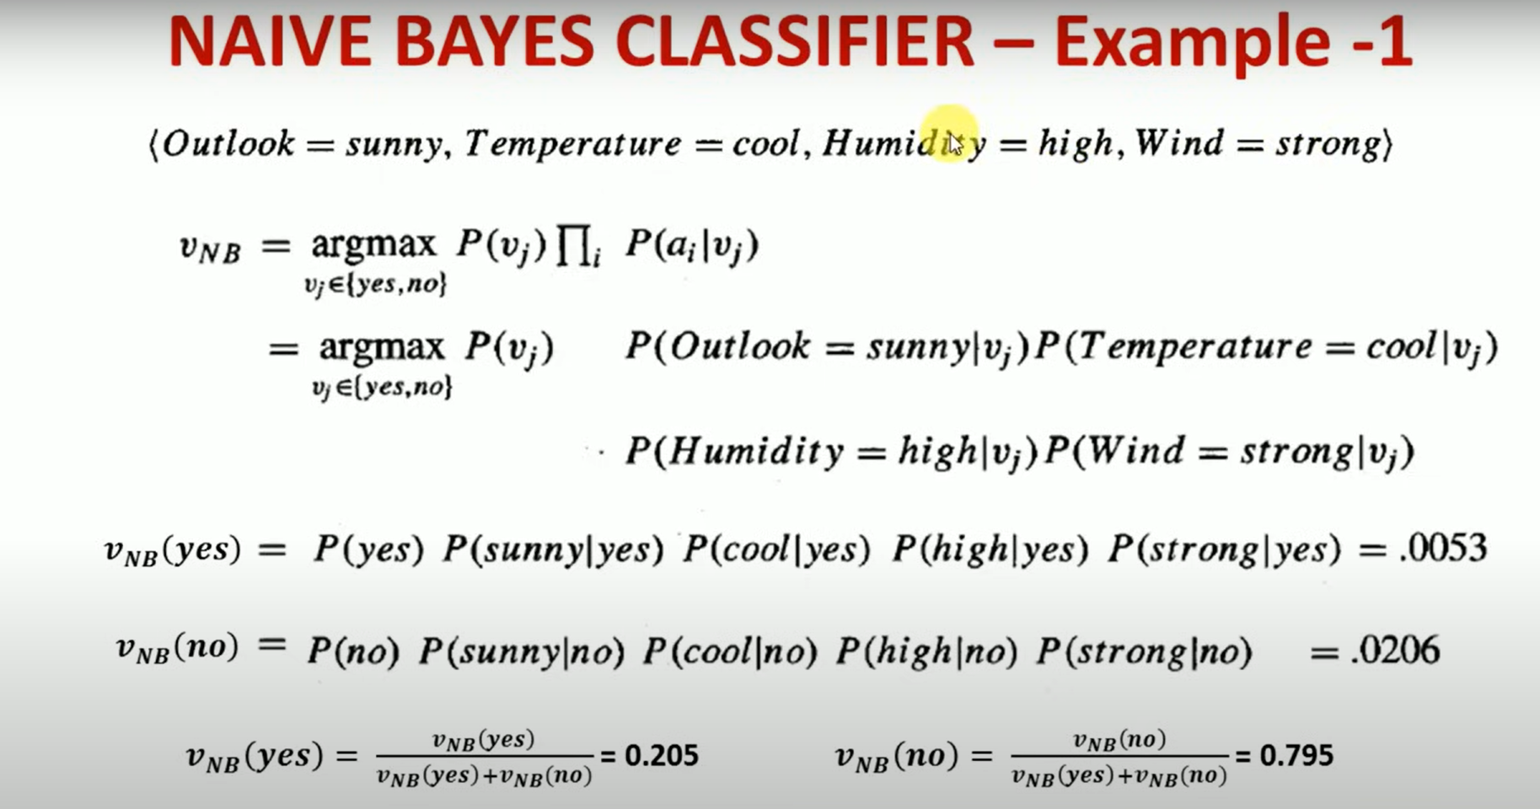

Slide 27
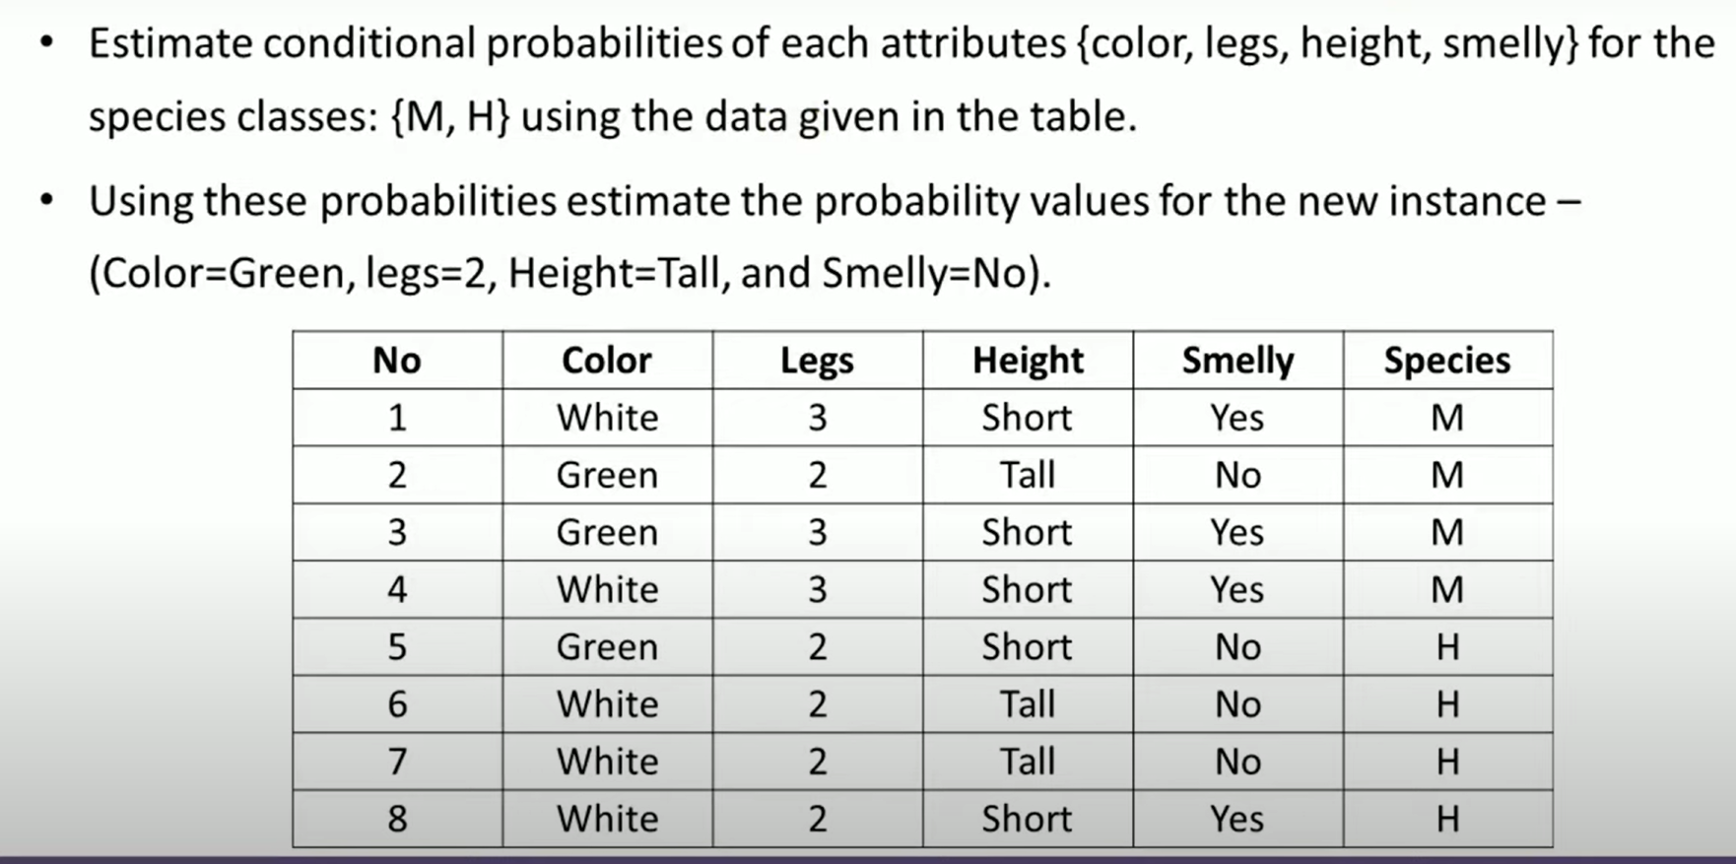

Slide 28
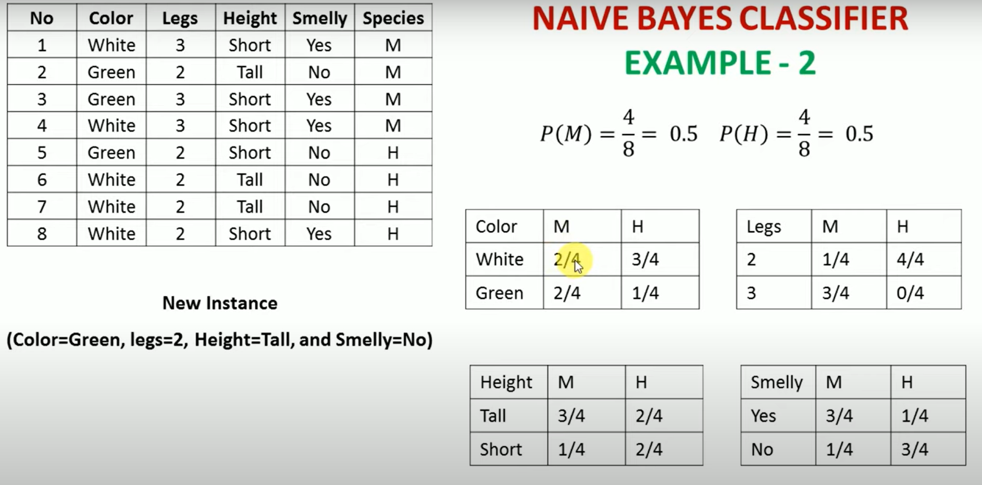

Slide 29
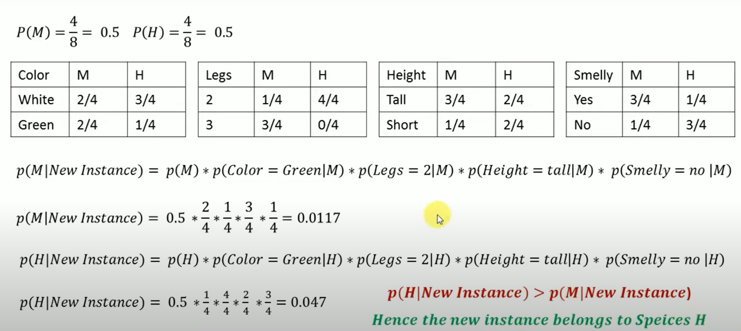

Slide 30
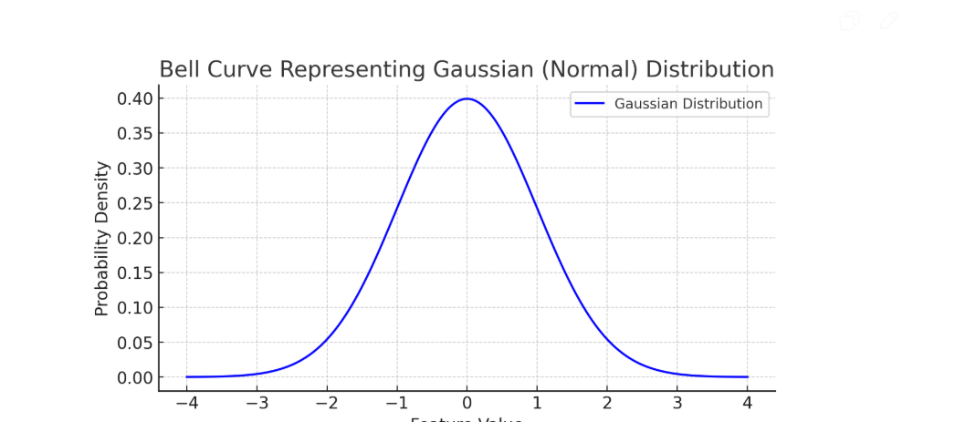
Naïve Bayes vs Gaussian Naïve Bayes
The Naive Bayes classifier is a family of probabilistic classifiers based on Bayes' Theorem with the naive assumption of feature independence.
Data type:Count (discrete)
Gaussian Naive Bayes is a specific type of Naive Bayes classifier that assumes the features follow a normal (Gaussian) distribution.
Data type : Continuous (real-valued)
It assumes that the continuous features follow a normal distribution (bell curve).

Slide 31
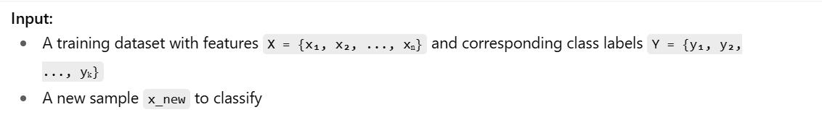
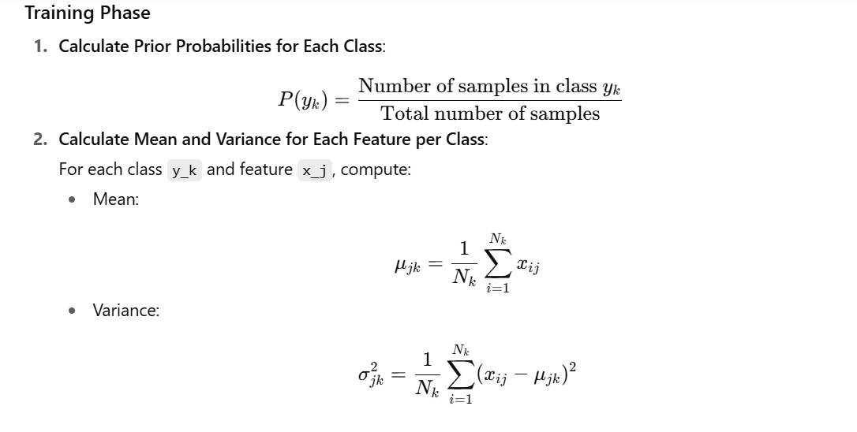
GAUSSIAN NAÏVE BAYES ALGORITHM

Slide 32
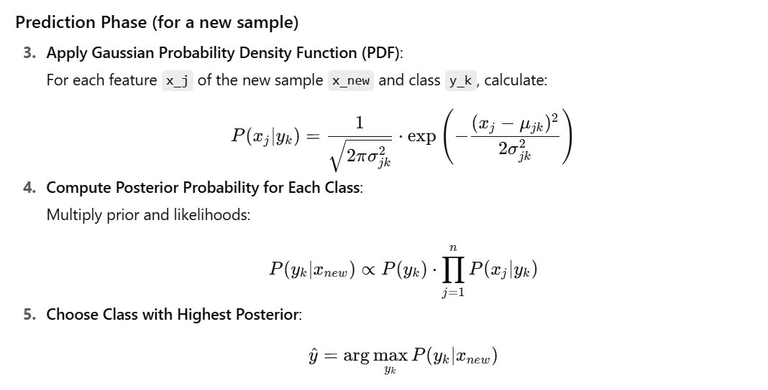

Slide 33
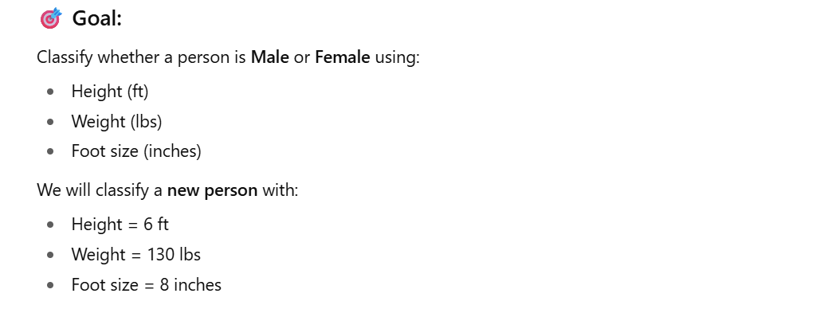

Slide 34
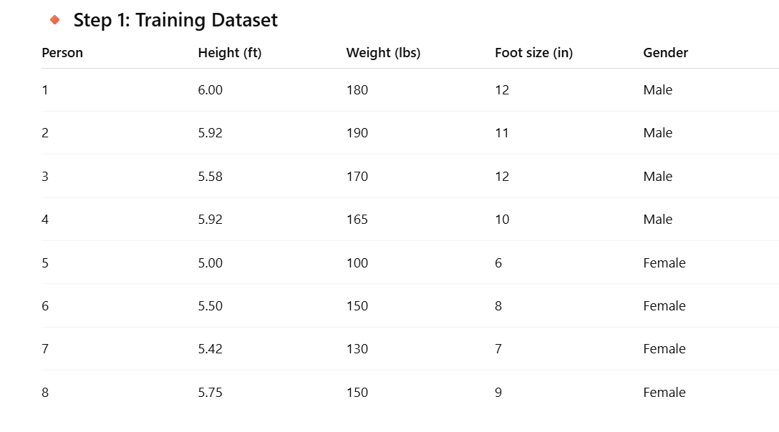

Slide 35
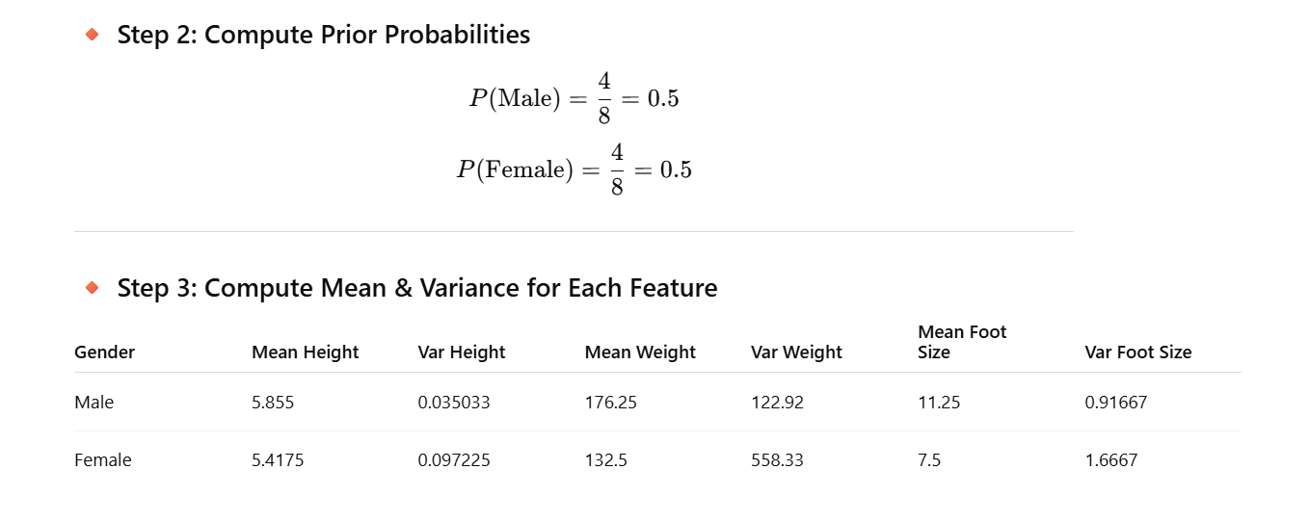

Slide 36
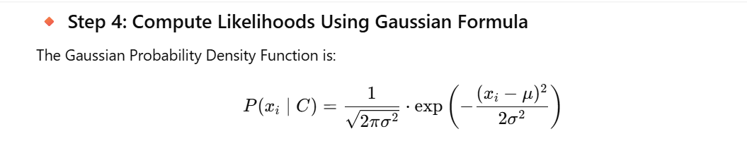
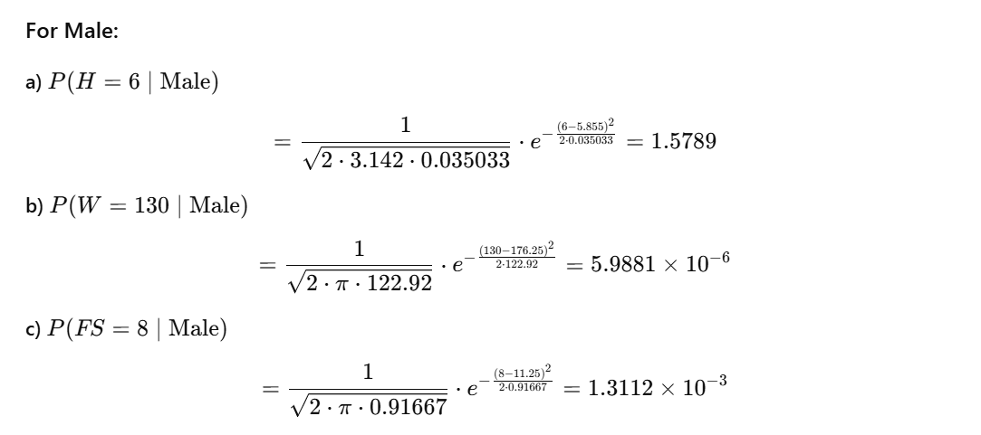

Slide 37
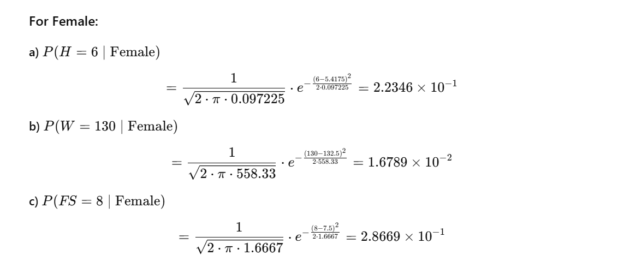

Slide 38
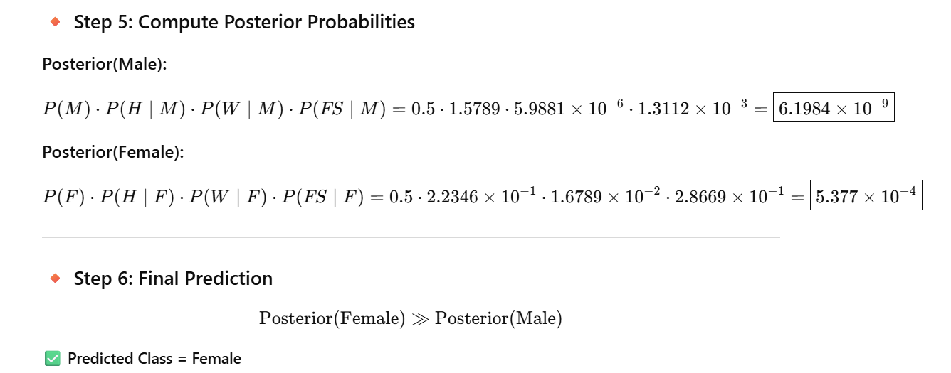

Slide 39
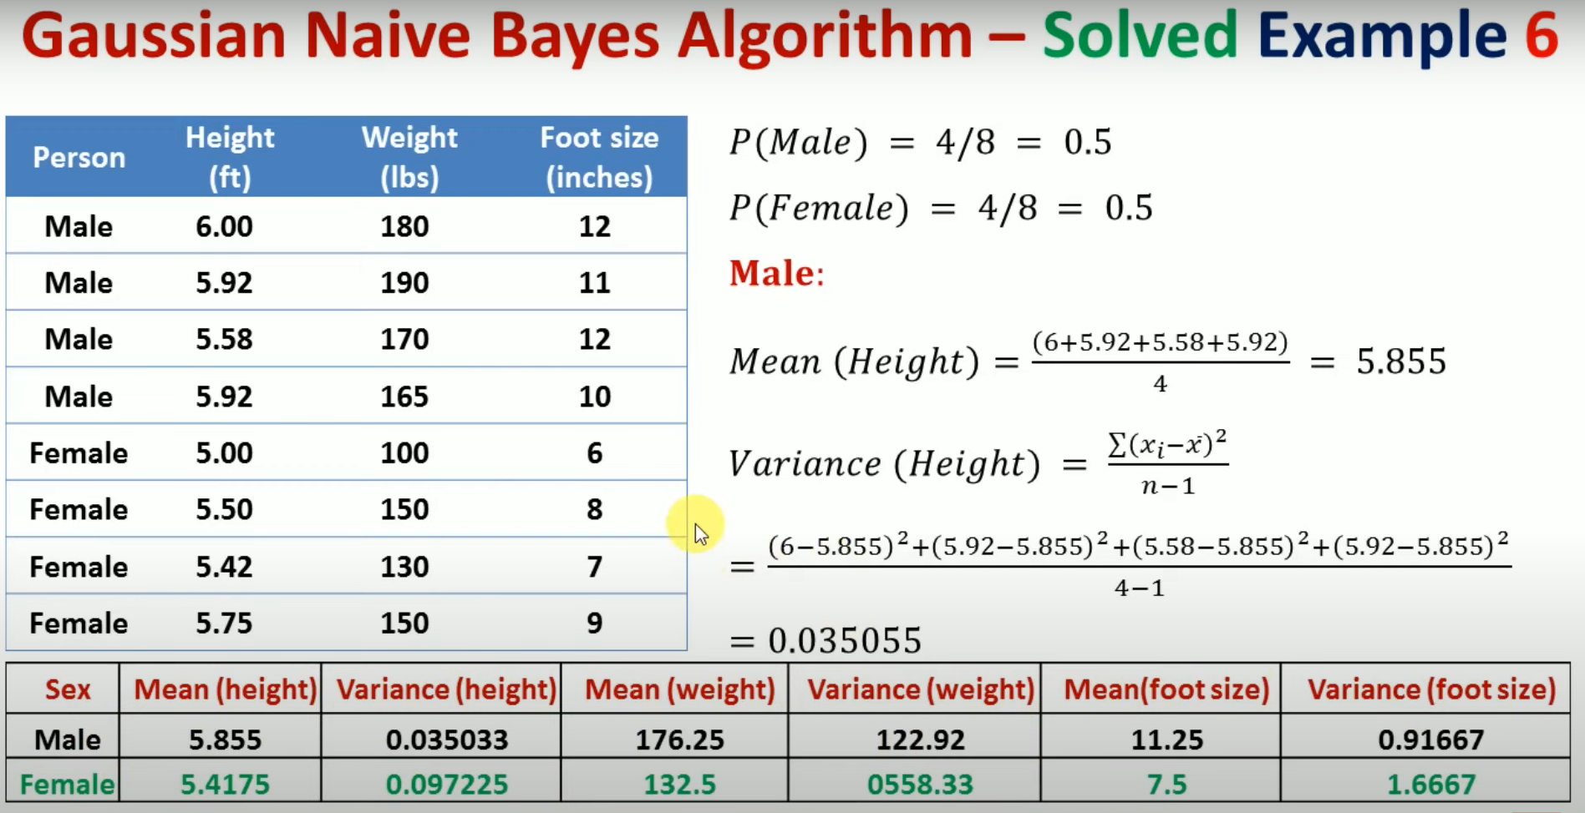

Slide 40
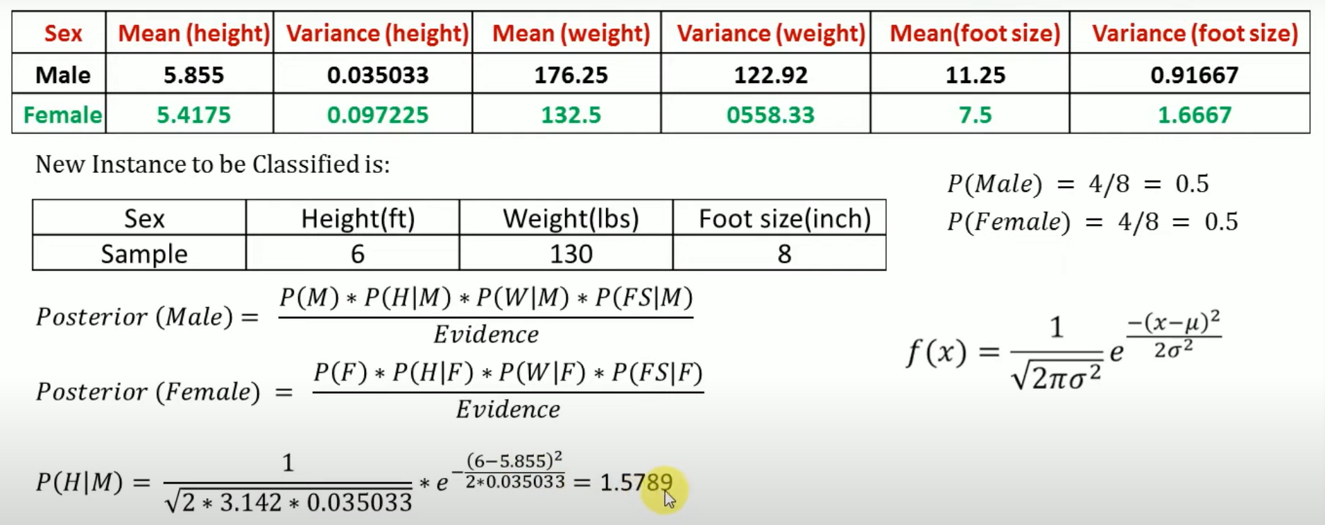

Slide 41
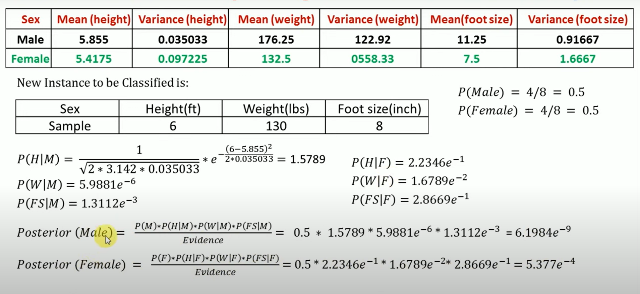

Slide 42
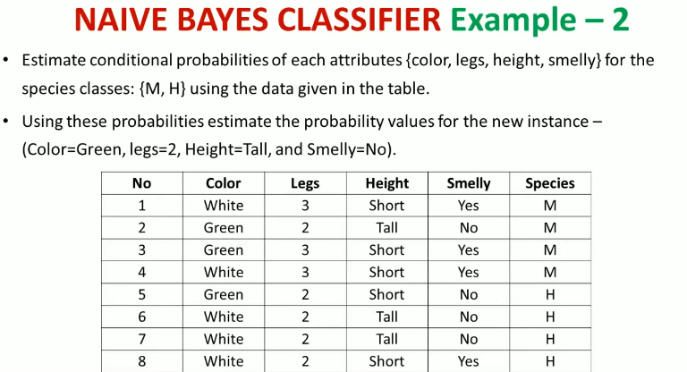
Class work problem

Slide 43
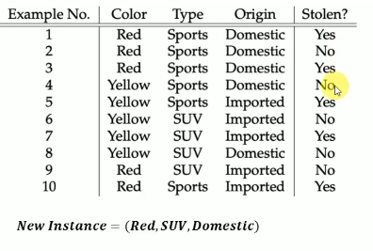

Slide 44
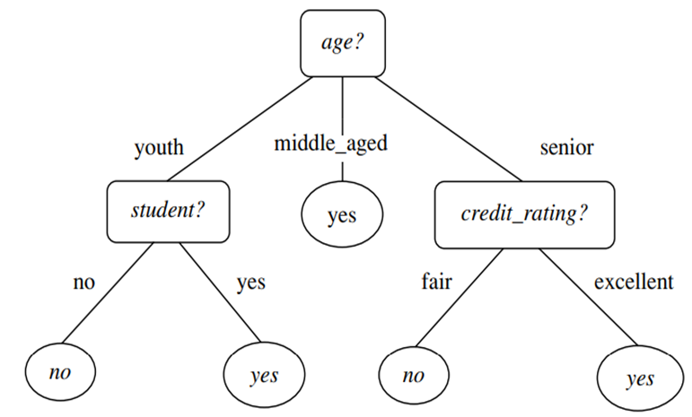
8.2 Decision Tree Induction
Decision tree induction is the learning of decision trees from class-labeled training tuples.
A decision tree is a flowchart-like tree structure, where each internal node (nonleaf node) denotes a test on an attribute, each branch represents an outcome of the test, and each leaf node (or terminal node) holds a class label.
The topmost node in a tree is the root node.
Figure 8.2
A typical decision tree is shown in Figure 8.2. It represents the concept buys computer, that is, it predicts whether a customer at AllElectronics is likely to purchase a computer. Internal nodes are denoted by rectangles, and leaf nodes are denoted by ovals.

Slide 45
8.2 Decision Tree Induction
Some decision tree algorithms produce only binary trees (where each internal node branches to exactly two other nodes), whereas others can produce nonbinary trees.
“How are decision trees used for classification?”
Given a tuple, X, for which the associated class label is unknown, the attribute values of the tuple are tested against the decision tree.
A path is traced from the root to a leaf node, which holds the class prediction for that tuple.
Decision trees can easily be converted to classification rules.

Slide 46
8.2 Decision Tree Induction
“Why are decision tree classifiers so popular?”
The construction of decision tree classifiers does not require any domain knowledge or parameter setting, and therefore is appropriate for exploratory knowledge discovery.
Decision trees can handle multidimensional data.
Their representation of acquired knowledge in tree form is intuitive and generally easy to assimilate by humans.
The learning and classification steps of decision tree induction are simple and fast.
In general, decision tree classifiers have good accuracy.
However, successful use may depend on the data at hand.

Slide 47
8.2 Decision Tree Induction
Decision tree induction algorithms have been used for classification in many application areas such as medicine, manufacturing and production, financial analysis, astronomy, and molecular biology.
Decision trees are the basis of several commercial rule induction systems.

Slide 48
8.2.1 Decision Tree Induction
During the late 1970s and early 1980s, J. Ross Quinlan, a researcher in machine learning, developed a decision tree algorithm known as ID3 (Iterative Dichotomiser).
This work expanded on earlier work on concept learning systems, described by E. B. Hunt, J. Marin, and P. T. Stone.
Quinlan later presented C4.5 (a successor of ID3), which became a benchmark to which newer supervised learning algorithms are often compared.
In 1984, a group of statisticians (L. Breiman, J. Friedman, R. Olshen, and C. Stone) published the book Classification and Regression Trees (CART), which described the generation of binary decision trees.
ID3 and CART were invented independently of one another at around the same time, yet follow a similar approach for learning decision trees from training tuples.
These two cornerstone algorithms spawned a flurry of work on decision tree induction.

Slide 49
8.2.1 Decision Tree Induction
The strategy is as follows.
The algorithm is called with three parameters:
D, attribute list, and Attribute selection method.
We refer to D as a data partition.
Initially, it is the complete set of training tuples and their associated class labels.
The parameter attribute list is a list of attributes describing the tuples.
Attribute selection method specifies a heuristic procedure for selecting the attribute that “best” discriminates the given tuples according to class.

Slide 50
8.2.1 Decision Tree Induction
This procedure employs an attribute selection measure such as information gain or the Gini index.
Whether the tree is strictly binary is generally driven by the attribute selection measure.
Some attribute selection measures, such as the Gini index, enforce the resulting tree to be binary.
Others, like information gain, do not, therein allowing multiway splits (i.e., two or more branches to be grown from a node).

Slide 51
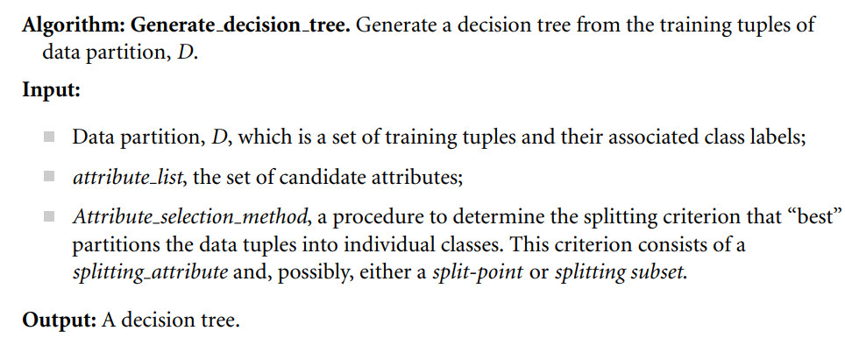
8.2.1 Decision Tree Induction

Slide 52
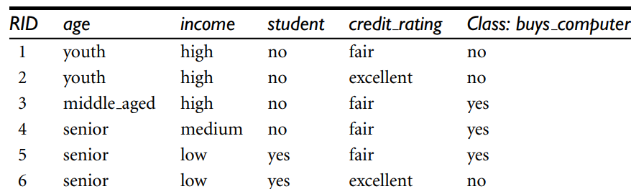

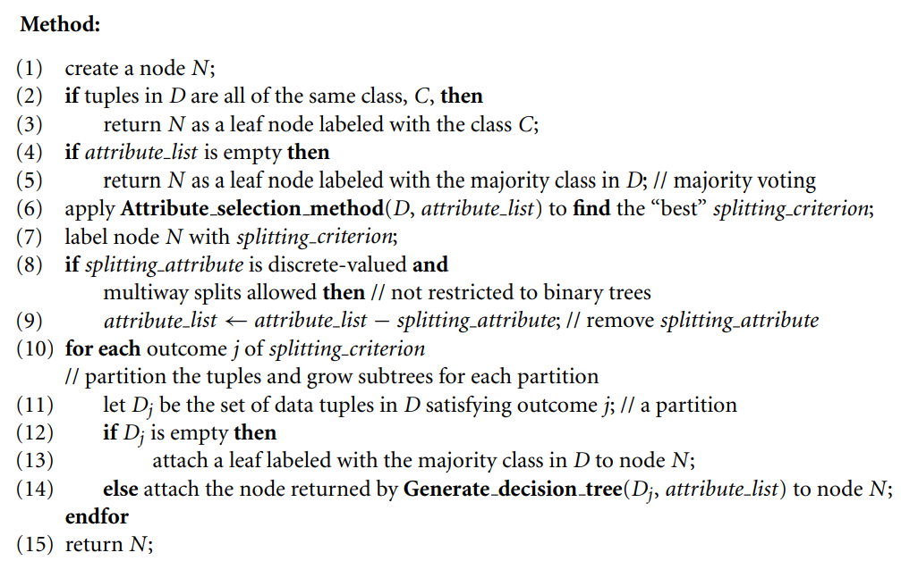
8.2.1 Decision Tree Induction

Slide 53
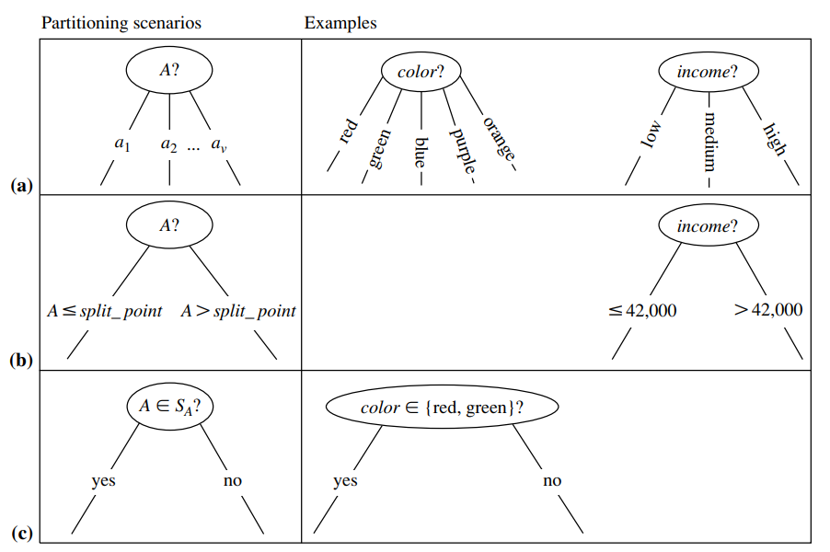
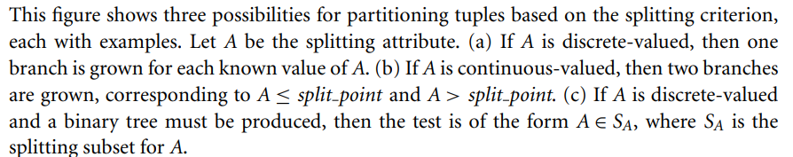
8.2.1 Decision Tree Induction

Slide 54
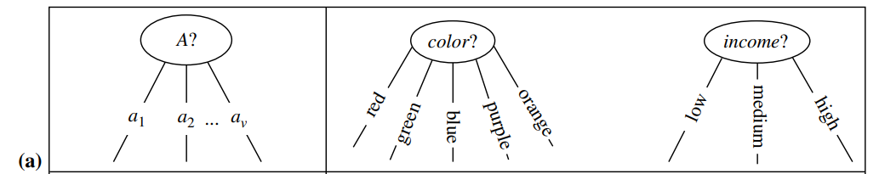
8.2.1 Decision Tree Induction
There are three possible scenarios, as illustrated in Figure 8.4.
Let A be the splitting attribute.
A has v distinct values, {a1, a2,..., av }, based on the training data.
A is discrete-valued: In this case, the outcomes of the test at node N correspond directly to the known values of A.
A branch is created for each known value, aj , of A and labeled with that value (Figure 8.4a). Partition Dj is the subset of class-labeled tuples in D having value aj of A.
A need not be considered in any future partitioning of the tuples. Therefore, it is removed from attribute list (steps 8 and 9)

Slide 55
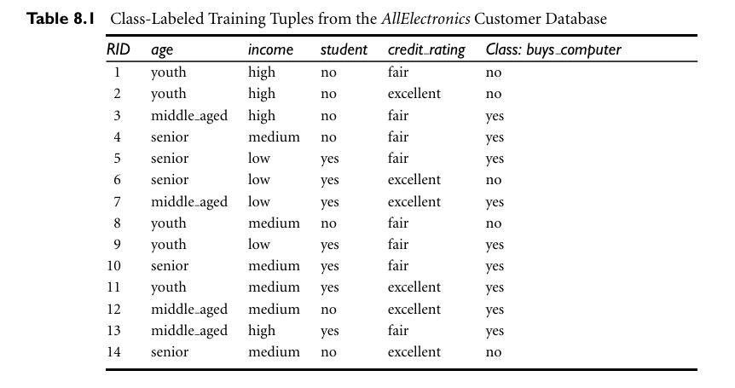

Slide 56
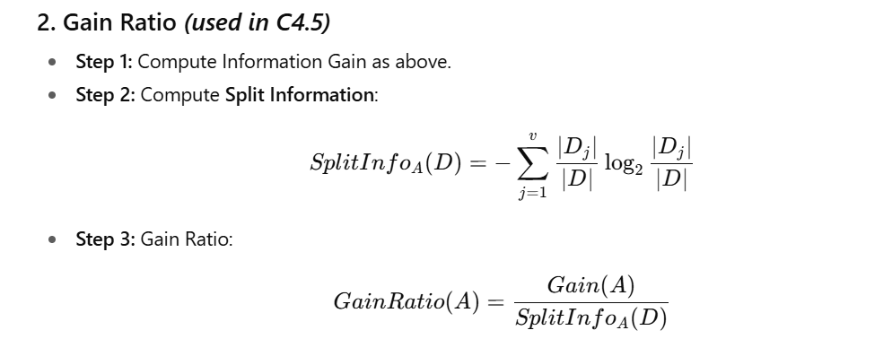
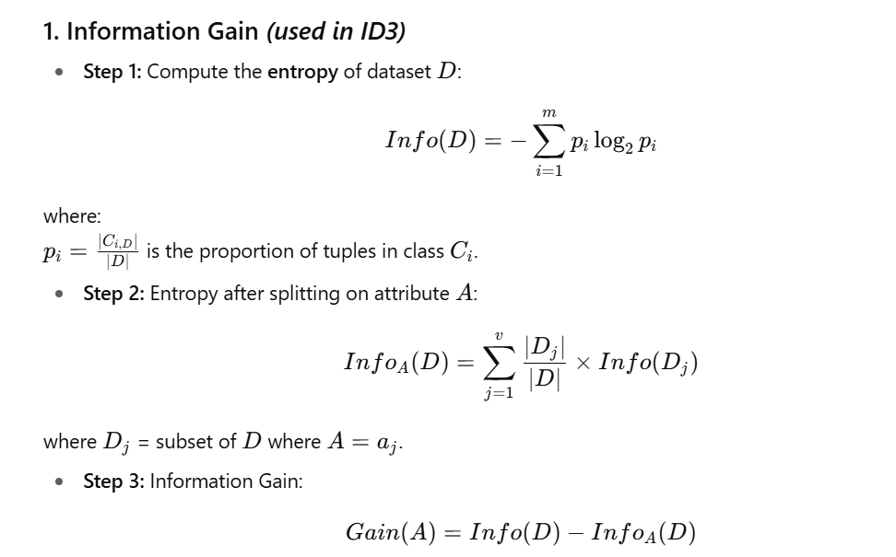
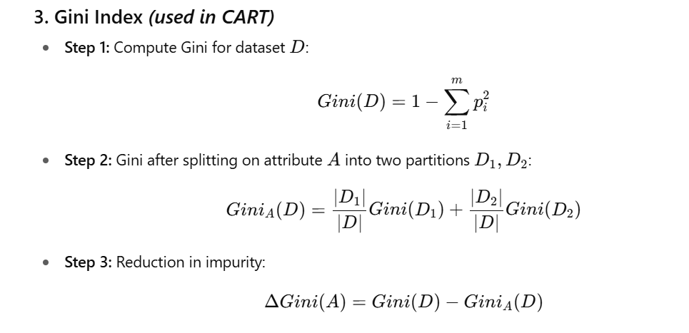
ATTRIBUTE SELECTION METHODS

Slide 57
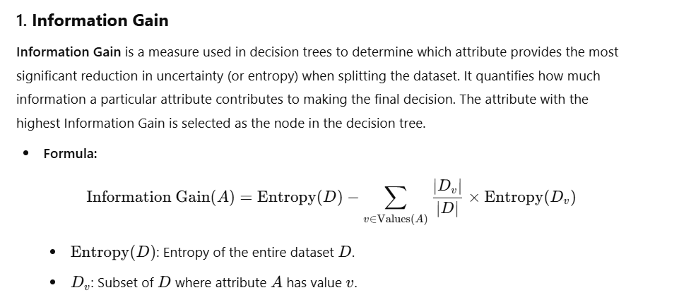

Slide 58
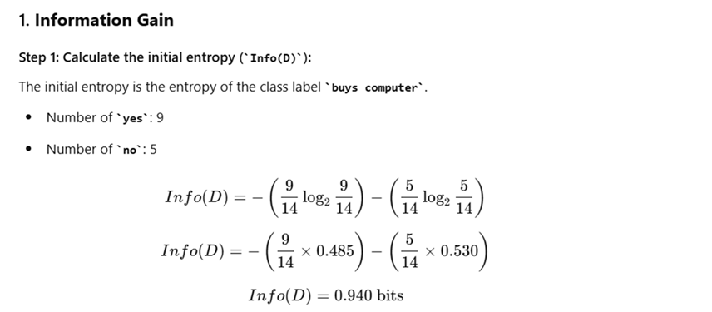

Slide 59


Yes
No
5 youth
4 Middle age
5 senior

Slide 60


Slide 61

Age has the highest information gain among the attribute and its is selected as the splitting attributes.

Slide 62


8.2.1 Decision Tree Induction
2.Gain Ratio
This value represents the potential information generated by splitting the training data set, D, into v partitions, corresponding to the v outcomes of a test on attribute A.
Note that, for each outcome, it considers the number of tuples having that outcome with respect to the total number of tuples in D.
The gain ratio is defined as
The attribute with the maximum gain ratio is selected as the splitting attribute.
Note, however, that as the split information approaches 0, the ratio becomes unstable.

Slide 63

8.2.1 Decision Tree Induction
Example 8.2 Computation of gain ratio for the attribute income.
A test on income splits the data of Table 8.1 into three partitions, namely low, medium, and high, containing four, six, and four tuples, respectively.
To compute the gain ratio of income, we first use Eq. (8.5) to obtain
For income ( Low) attribute 4/14
For medium 6/14
For high 4/14

Slide 64


Slide 65



Slide 66



